Slide 1


Project 2
Darryl Bunn
Antonio Gomez
Robert Riggs
Jonathan Torres

Slide 2
Requirements
Each team will be tasked with the analysis of a large dataset (10-15 thousand records) using our E-Commerce data structure.
Data should be processed and cleaned using PySpark.
A Power BI report should be created and visualizations shown answering specific analysis questions

Slide 3
TECH STACK
Python
Pyspark
PowerBI

Slide 4
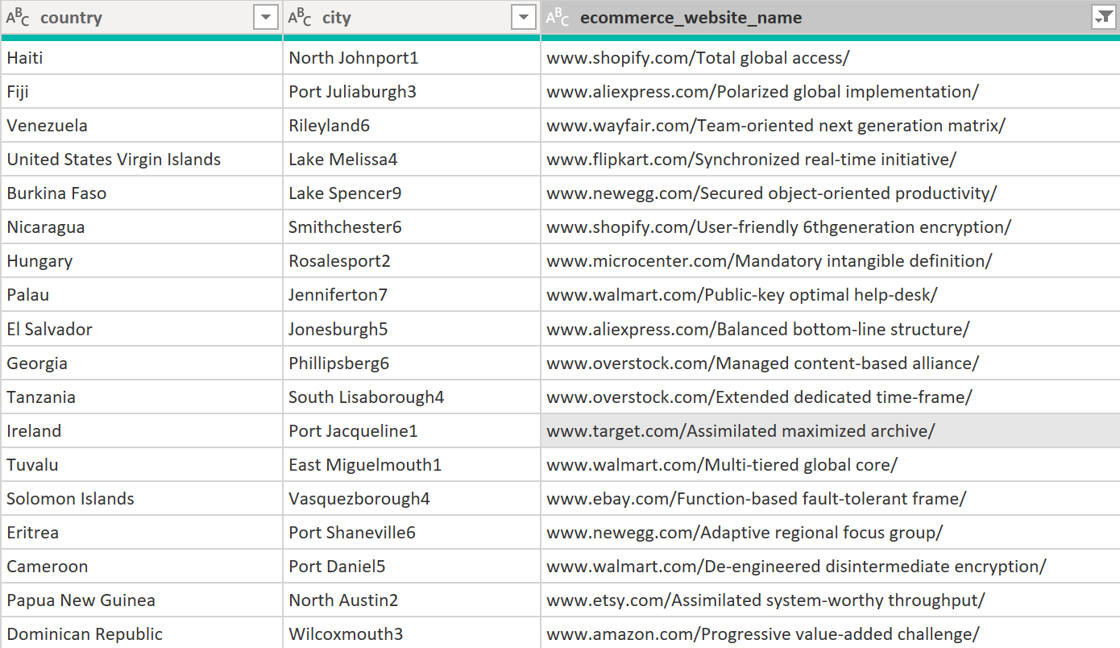
BAD DATA

Slide 5
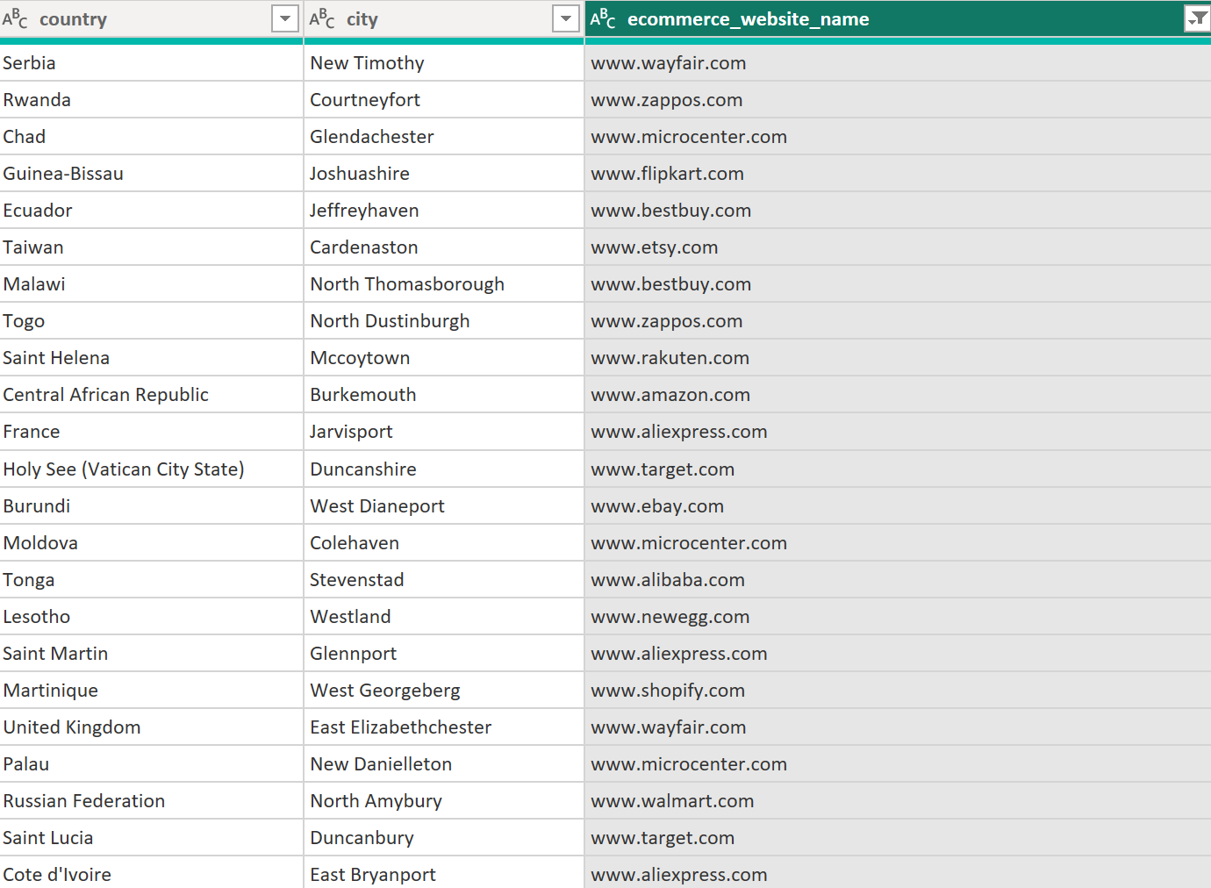
GOOD DATA​

Slide 6

What Categories see the most Sales?

Slide 7
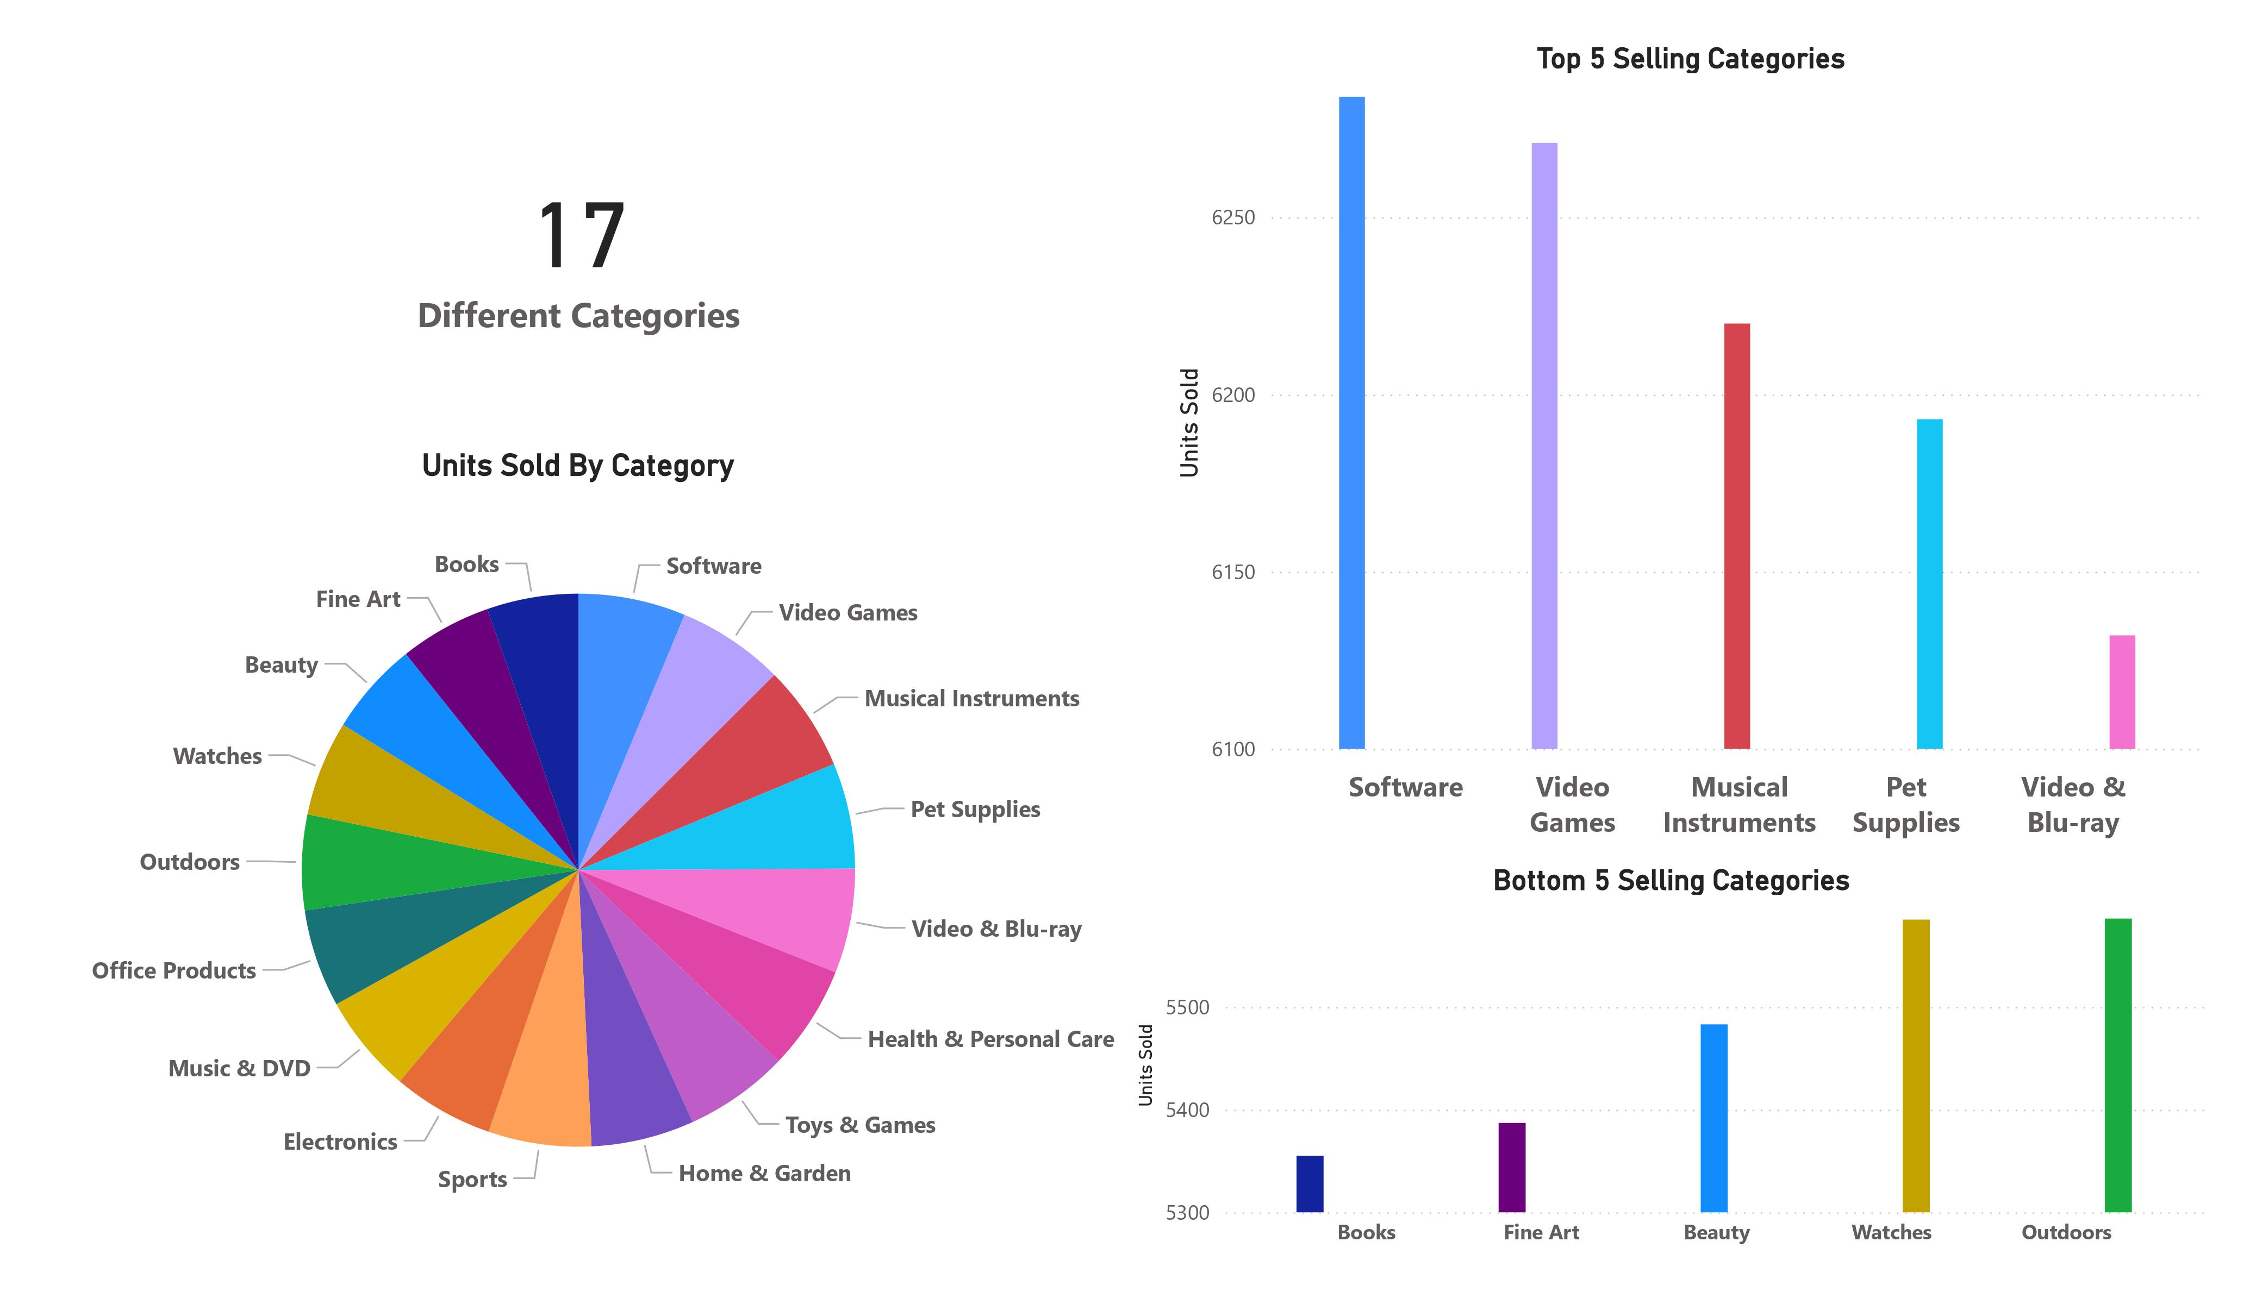

Slide 8
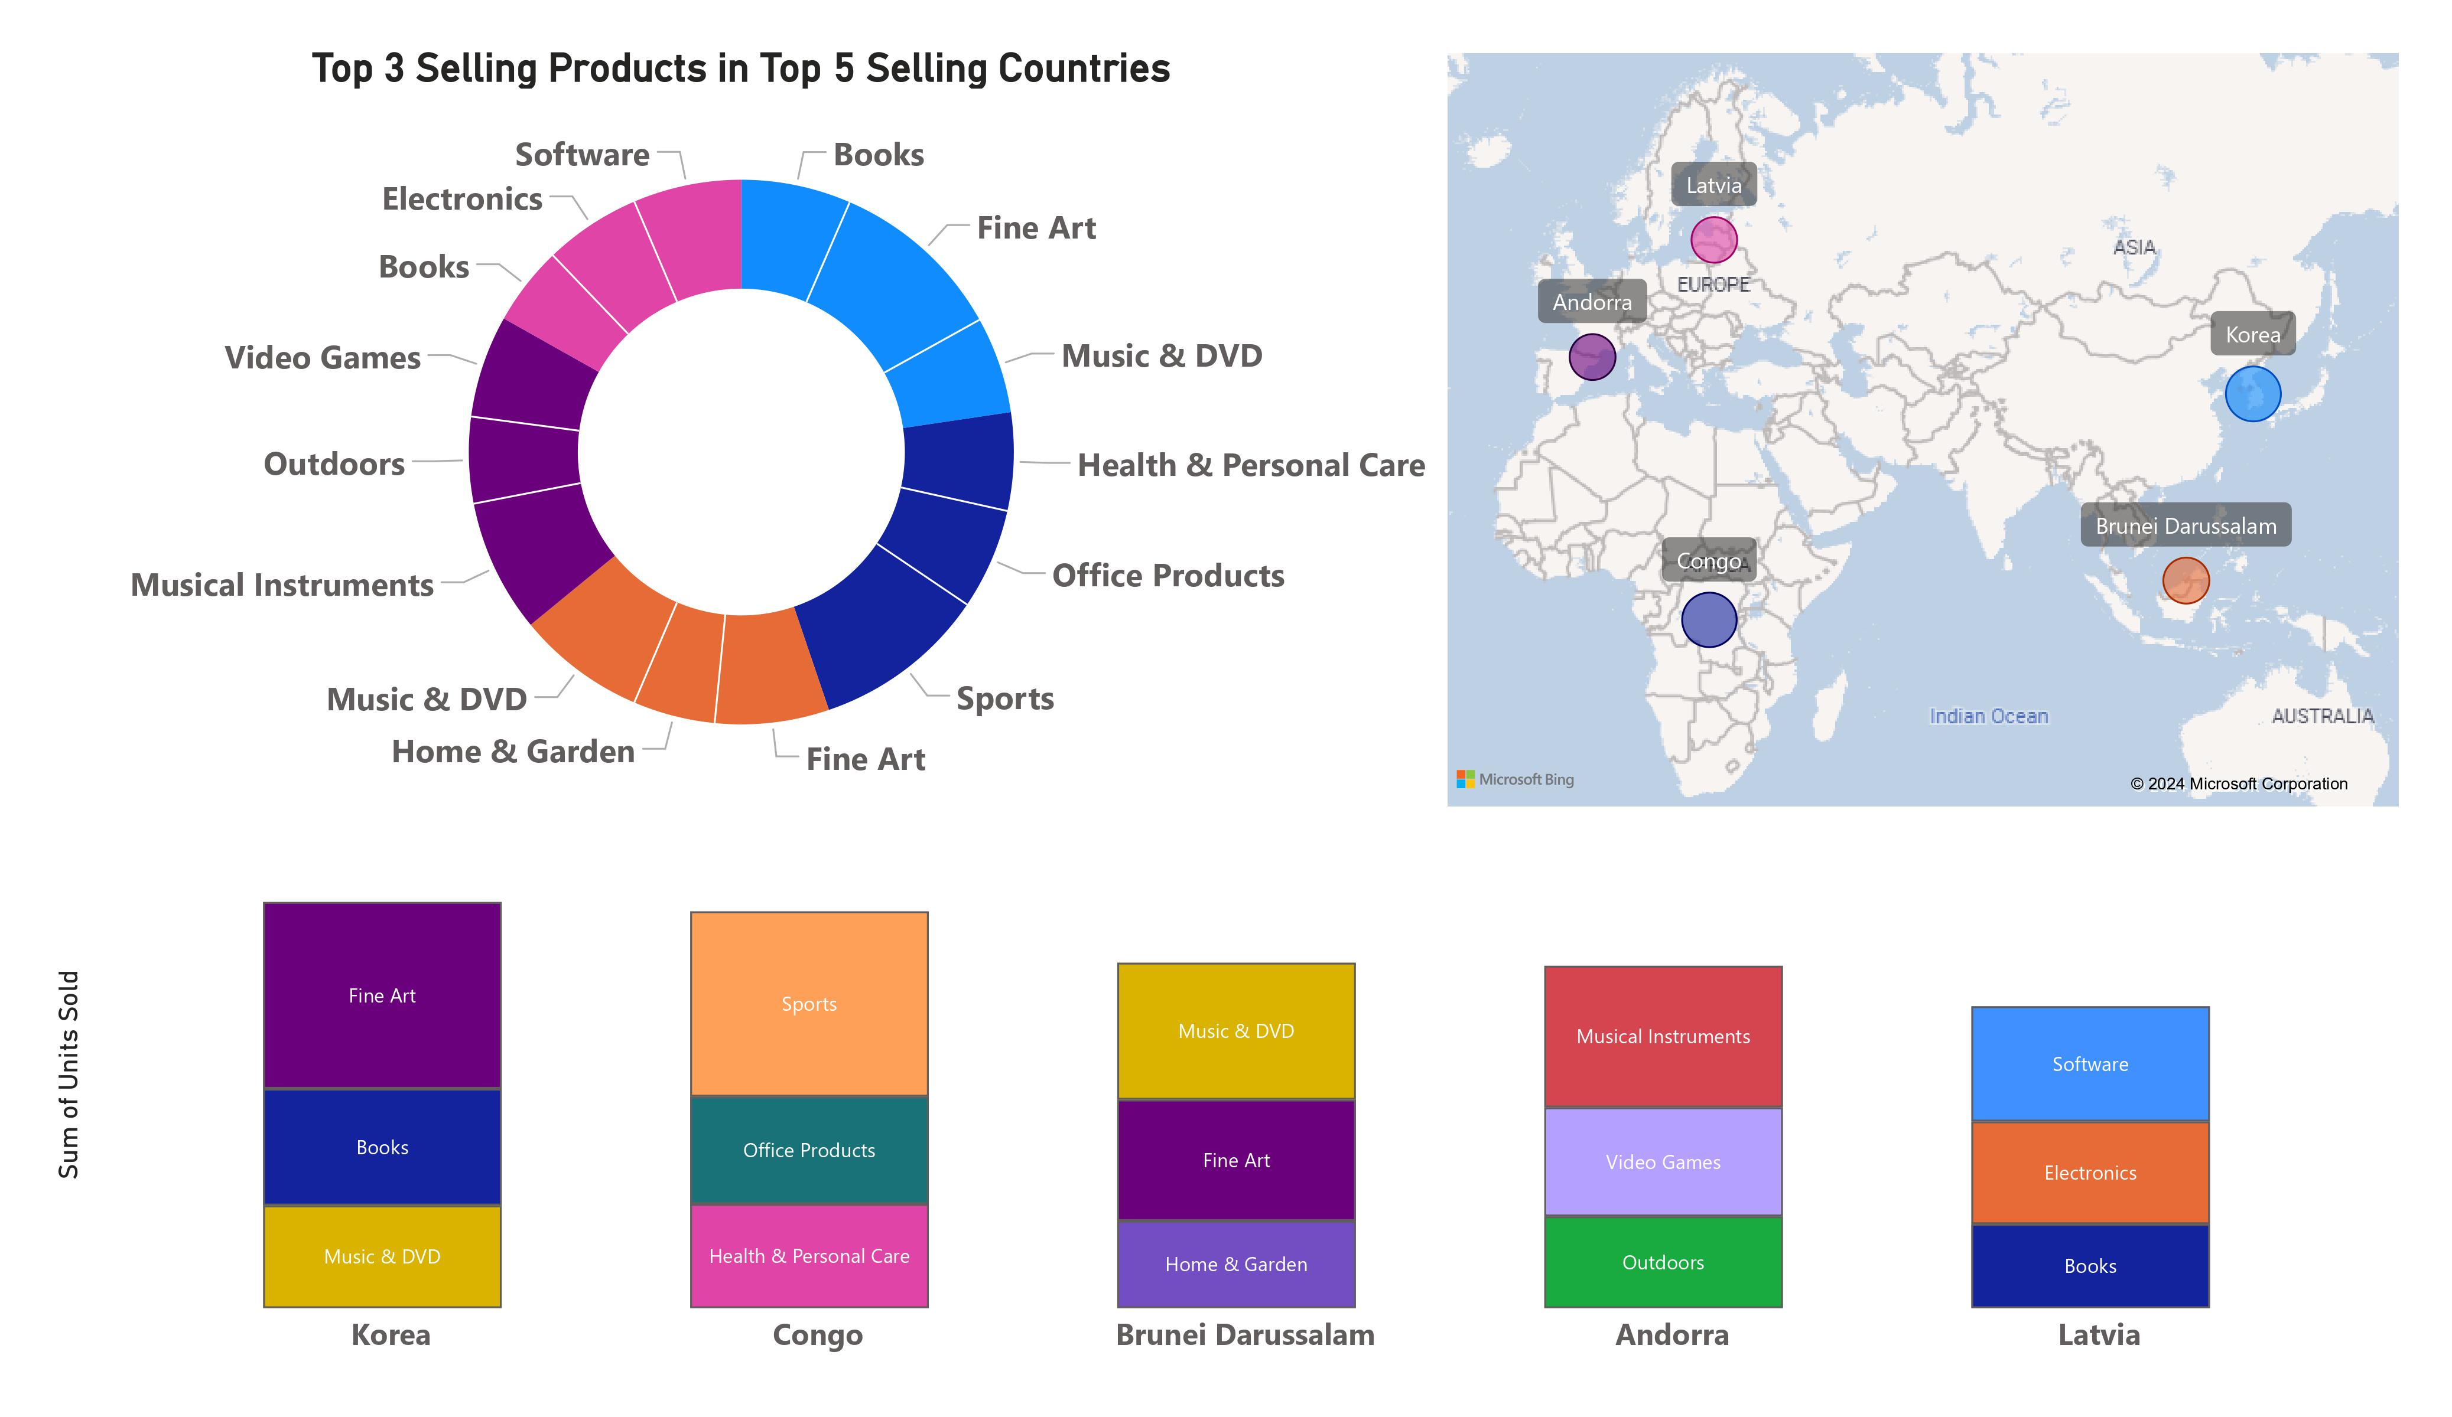

Slide 9
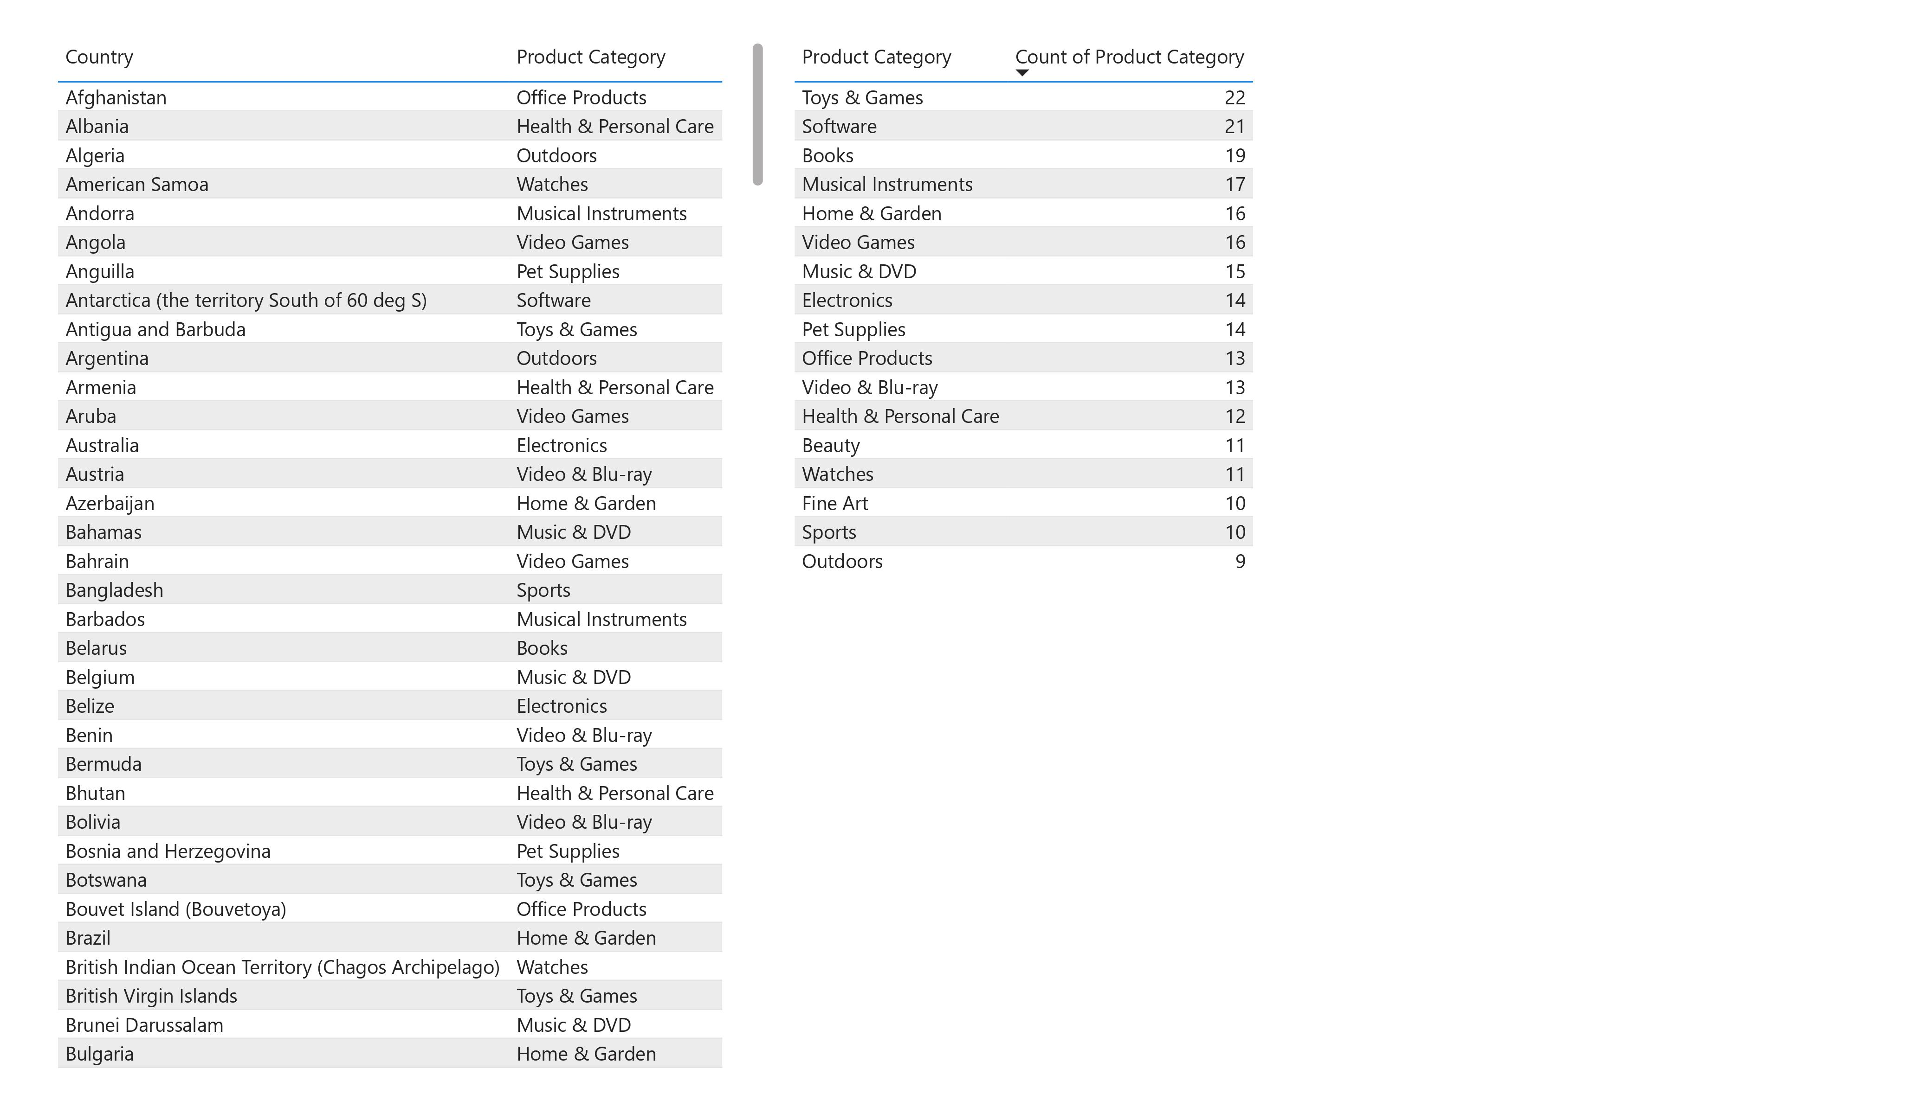

Slide 10

How does the popularity of products change throughout the year?

Slide 11
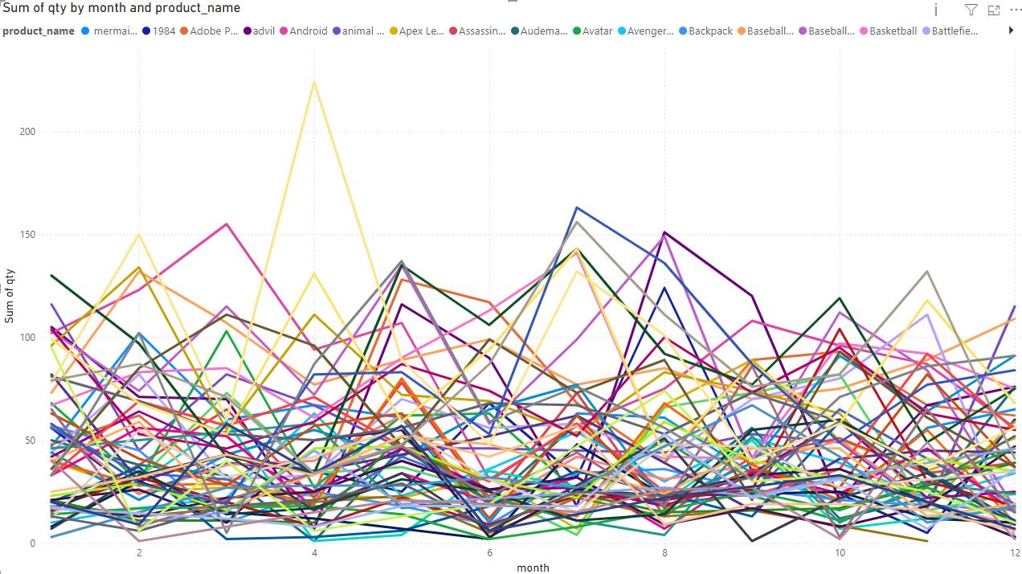
How does the popularity of products change throughout the year?

Slide 12
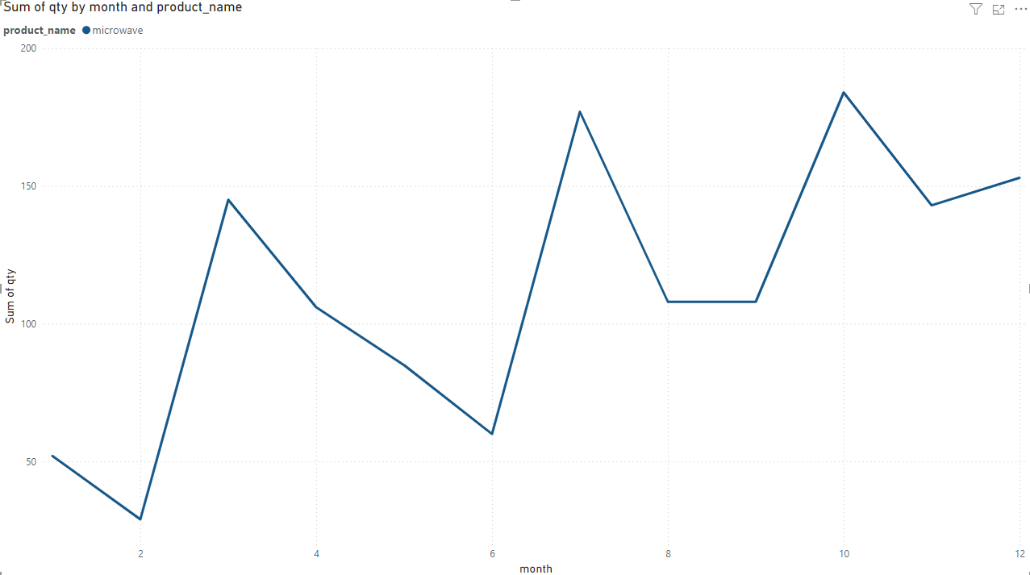
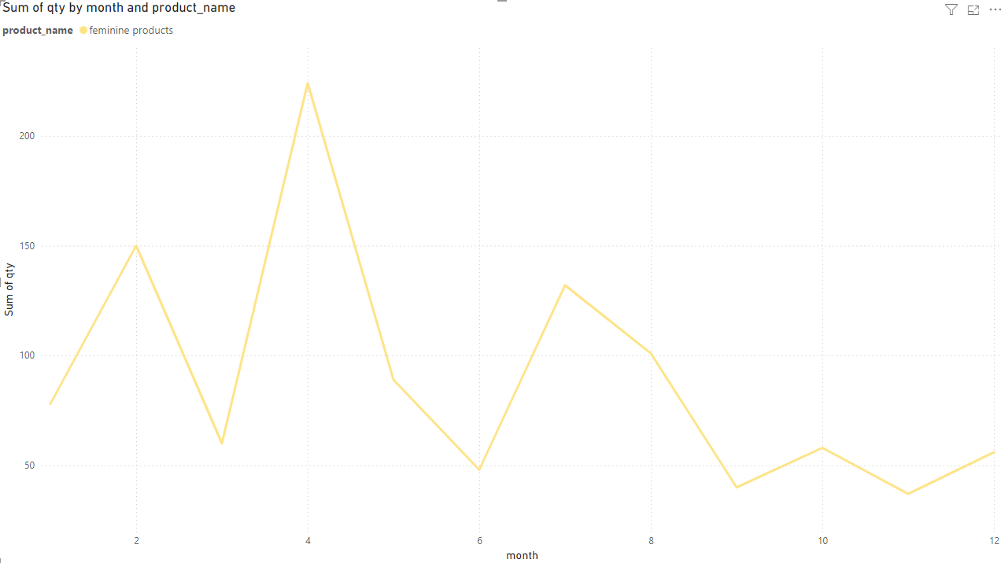
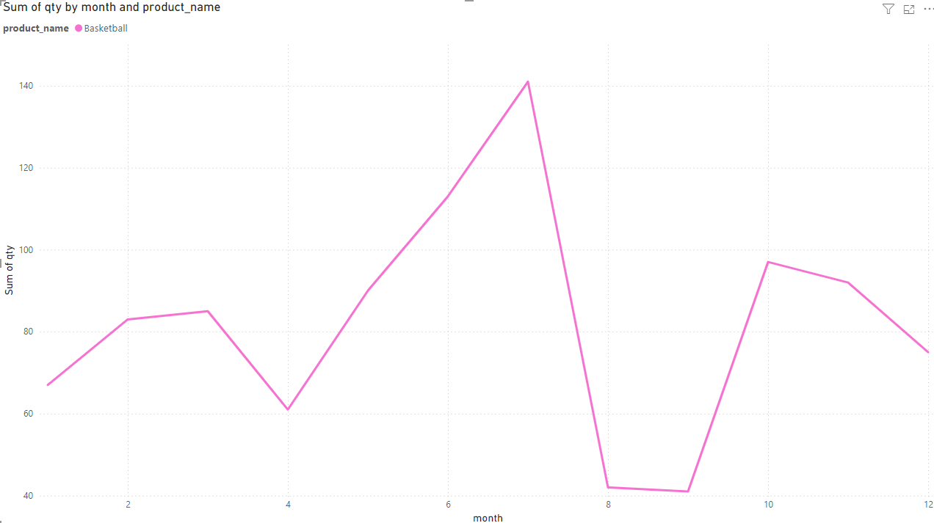
Examples of filtering by certain products

Slide 13
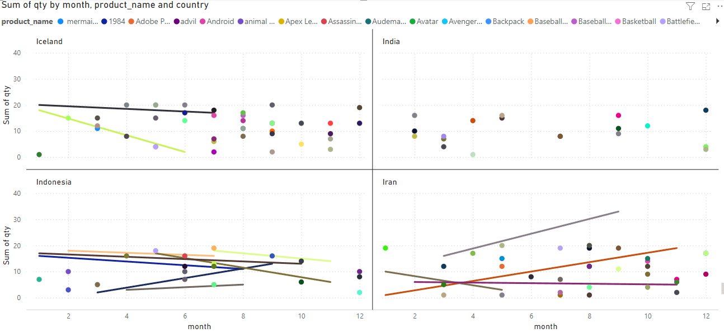
How does the popularity of products change throughout the year, per country?

Slide 14
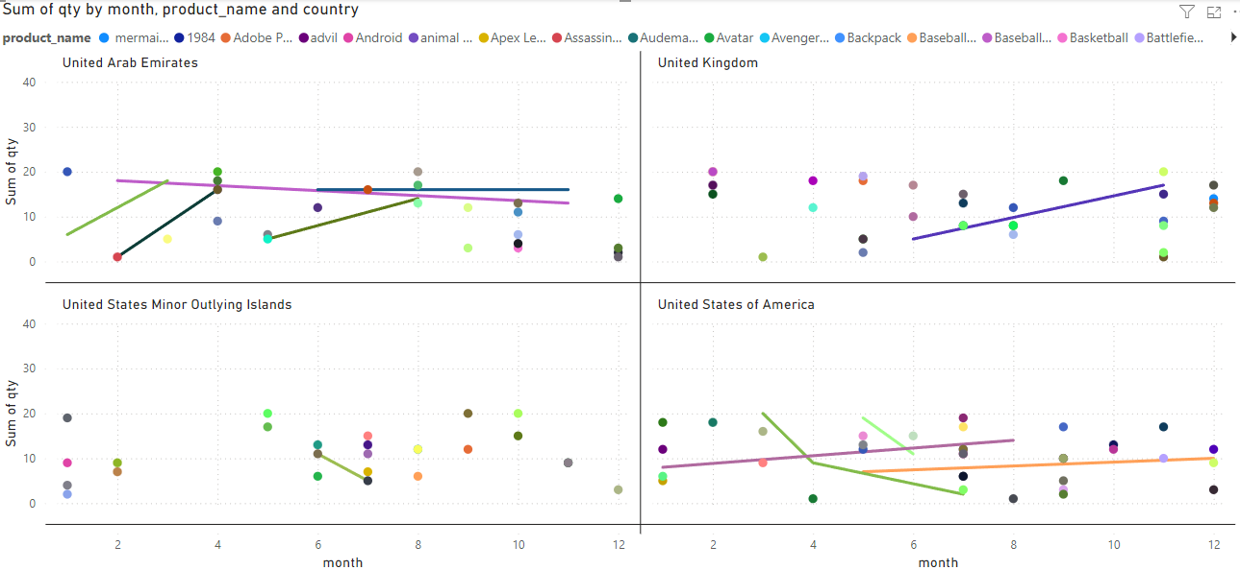

Slide 15
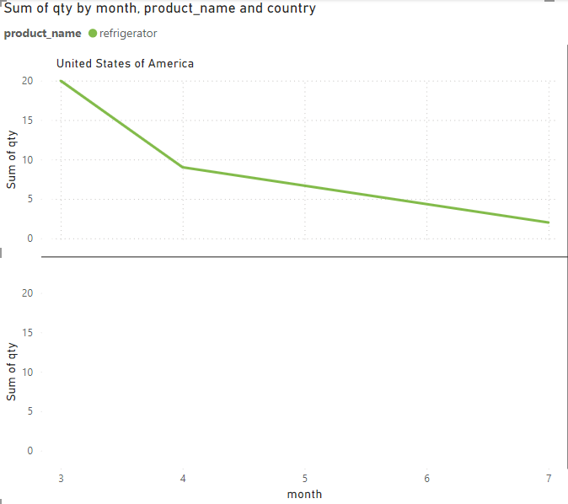
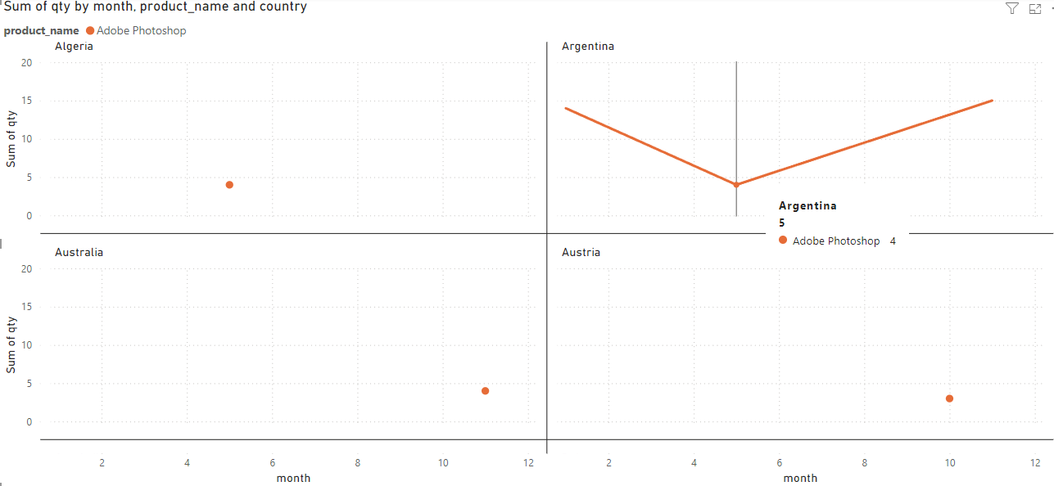
Example of filtering by a specific country and product
Example of filtering by a specific product

Slide 16

Which locations see the highest traffic of sales..

Slide 17
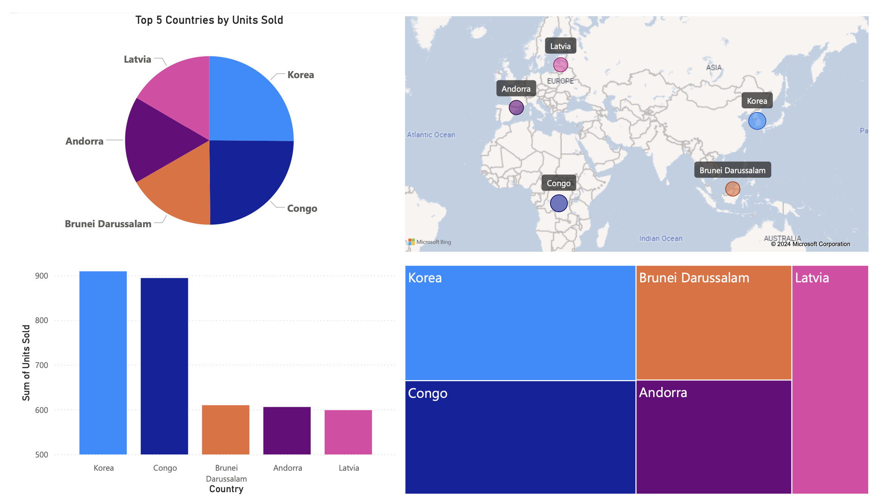

Slide 18
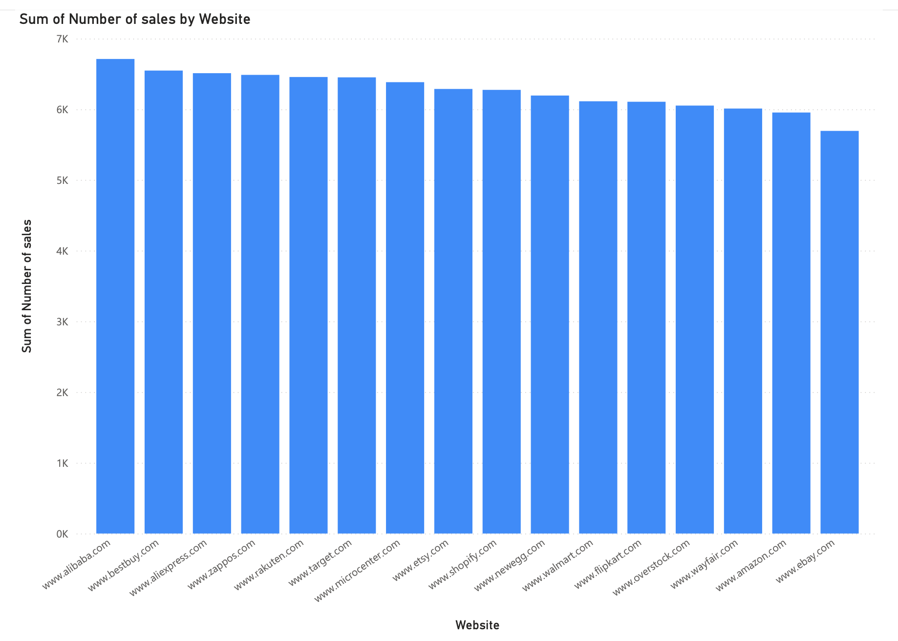
By website

Slide 19
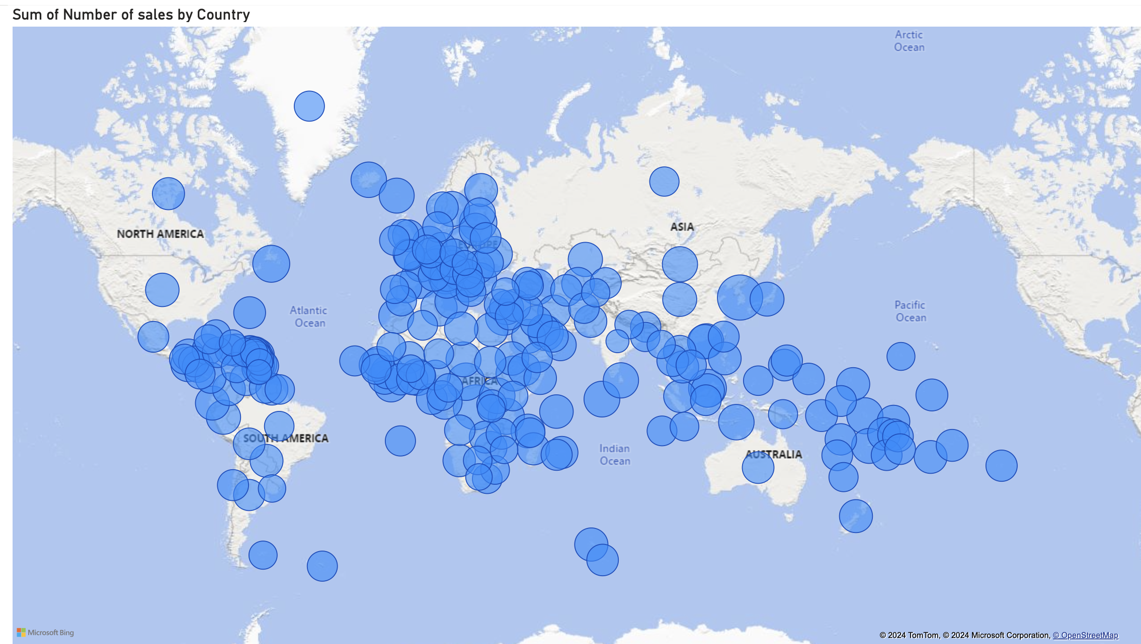
Number of sales by country

Slide 20
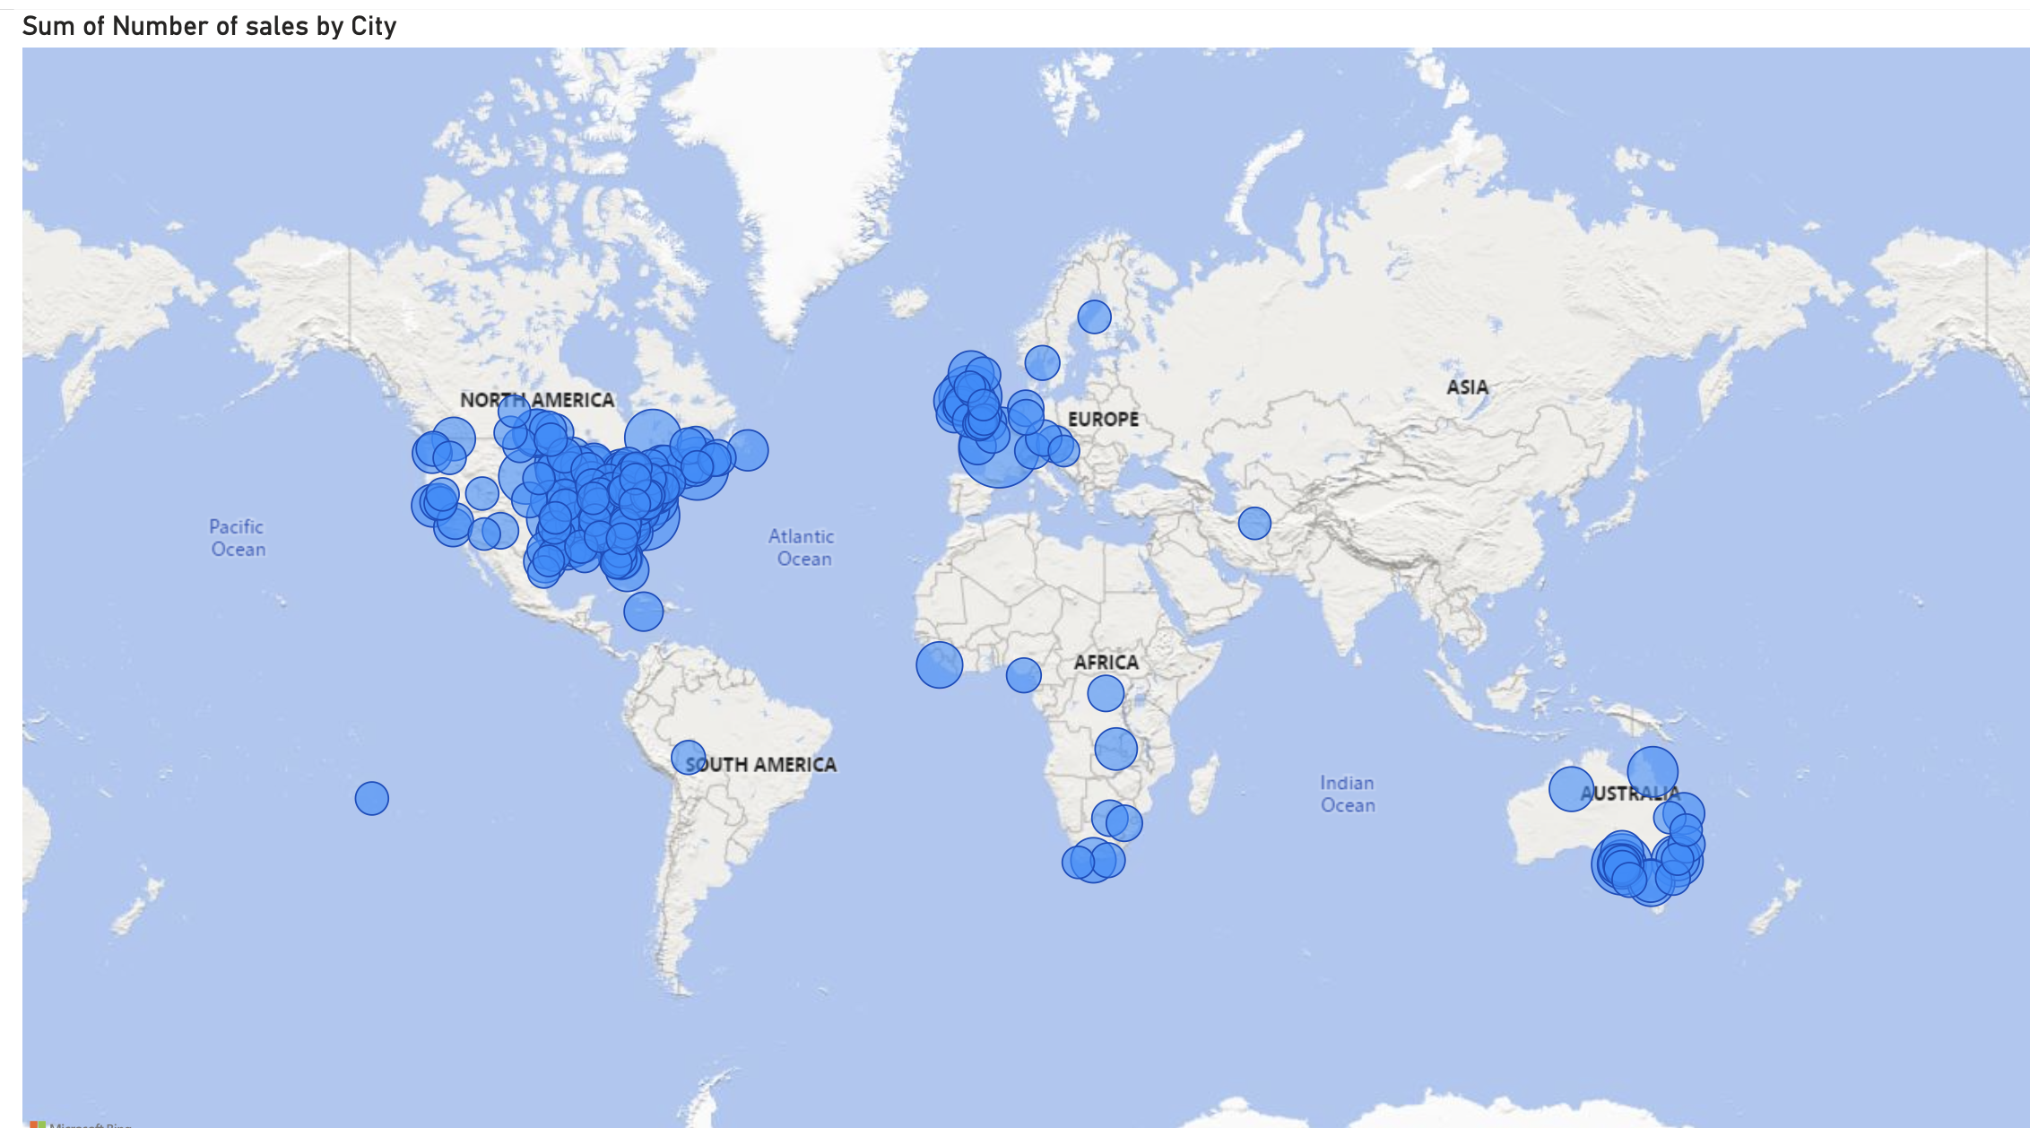
Number of sales by city

Slide 21
What times have the highest traffic of sales? Per country?

Slide 22
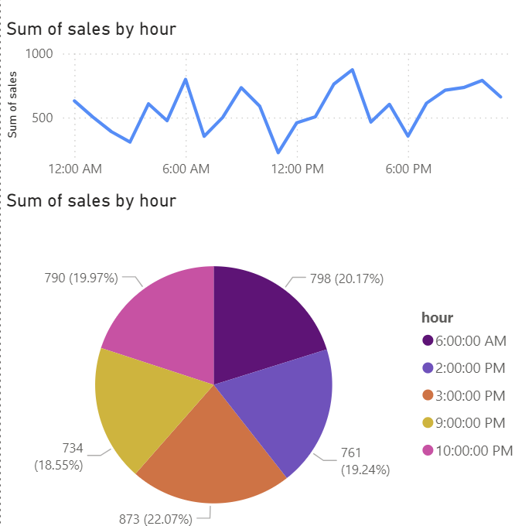
Peak Hours

Slide 23
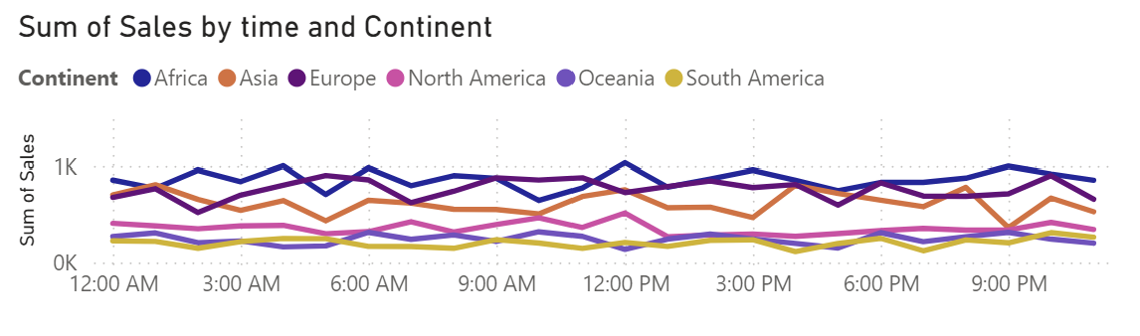
CONTINENT

Slide 24
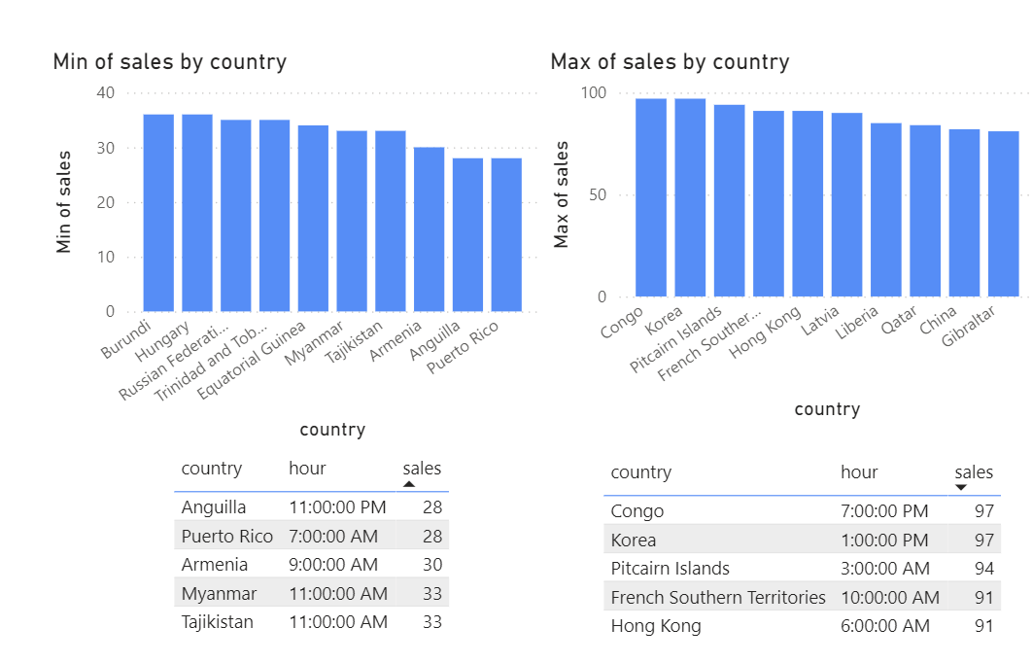
Top Countries
Bottom Countries

Slide 25

Observations
Since most of our sales occur in the middle/East countries, targeting those countries with marketing strategies can yield the greatest return based off geographical location.
While the most selling category of product is Software overall, the top selling category in most countries is Toys and Games. Perhaps with more advertising we can increase those revenue streams.
Different products sell better during varying months of the year due to their individual qualities. Focusing marketing on popular products during the months where their popularity is at its height may boost sales further.

Slide 26

QUESTIONS?

